Slide 1

WIS 2.0 Training Workshop, Windhoek, Namibia, 20-24 March 2023​
Introducing WIS2 in a box
Tom Kralidis
Senior Geospatial Architect
Meteorological Service of Canada
tom.kralidis@ec.gc.ca
@tomkralidis

Slide 2
WIS2 in a box History
Principles
Demonstration projects
WIS2 in a box
Architecture
Implementation
Workshop on WIS 2.0 demonstration projects (September 2021)
Demonstration of WIS 2.0 principles by WMO Community
Foundation of WIS 2.0 Architecture
WIS2 in a box (November 2021)
Facilitate adoption of WIS2 by Members
Reference implementation of the Technical Regulations of WIS2
WIS2 in a box
Open-source reference implementation of WIS 2.0 for LDC, SIDS and Members adopting open-source solutions
Plug and play
Data exchange
Use & Visualize
Discover
Monitor

Slide 3








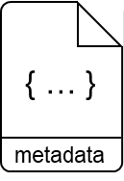
WIS2 in a box: What is it?
WIS2 in a box is a reference implementation of a WIS2 Node
MQTT
HTTP
Software (not hardware)
Publishing facility/capability compliant to WIS 2.0 Architecture
Provides basic data transformation
Can integrate with existing data management systems
Global Broker
subscribe
notification
of new data
notification
of new data
Data
Consumer
subscribe
download
Message Broker
Core Data
WIS2 Node
Recommended
3

Slide 4
WIS2 in a box features
Plug and play
Data exchange
Use & Visualize
Discover
Monitor
Free and Open Source Software (FOSS)
Based on standards (OGC/ISO/W3C)
Cloud technology
Deploy
Cloud service
On premises
Data conversion (CSV to BUFR, …)
Simple to configure
Publish – subscribe (Message Queuing Protocols)
Upload / download
National network data
International data
Satellite, NWP
Based on OGC standards
Find data from other Countries and areas
Find forecast and analysis
Find satellite data
Visualise the status of National stations
Monitor the continuity of data transmission
Provide data to central monitoring tools

Slide 5
















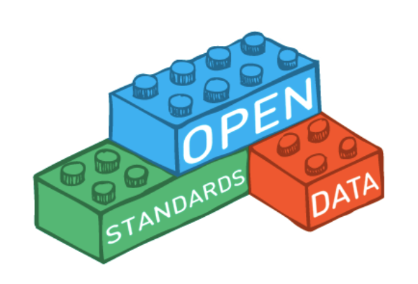
WIS2 in a box is Free and Open
Free and Open Source Software
Open Standards
MQTT
GeoJSON
OGC APIs

Slide 6
WIS2 in a box is WIS 2.0 compliant
Core services
Optional services
MQTT 3.1.1 or 5.0
Publish real-time notifications of new data and metadata to subscribers (Global Broker).
Web Accessible Folder (WAF)
HTTP URL in notification message is a link to a WAF
Subscribe
Subscribe to notifications from Global Broker
Download data
Download data from Global Cache after receiving notification from Global Broker
OGC APIs (API)
Discovery
Access
Visualization
Processing
User Interface/Web Application
Access control

Slide 7


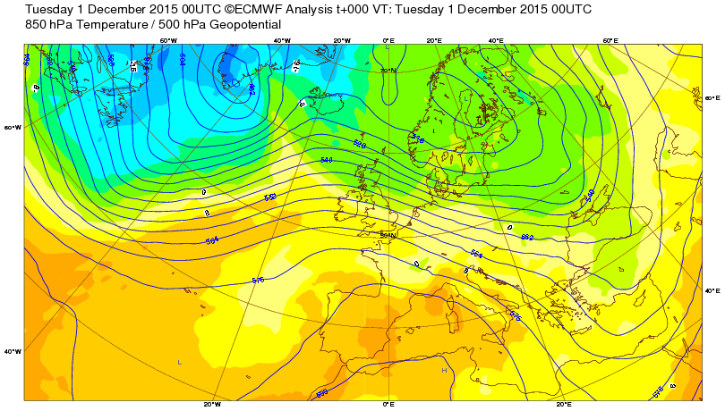
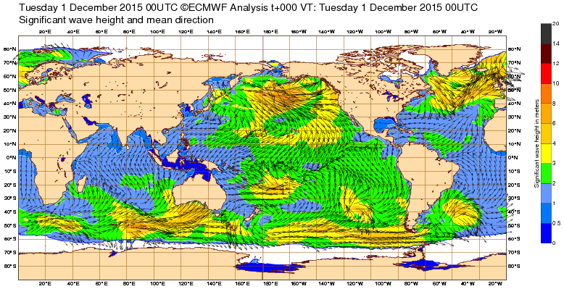
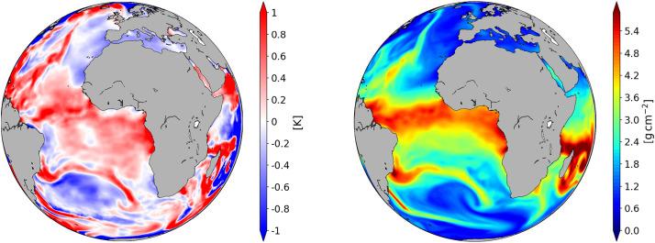
Subscribe/Download: WIS2 in a box supports WMO Unified Data Policy
free real-time access to core data
WIS2 Global Services
WMO core data are free and unrestricted
Others’ Core data
My Core data
WIS2 box downloads core data from Global Services
WIS2 box
Others’ Core data
My Core data
WIS2 box makes available core data for publication by Global Services

Slide 8
Publish: WIS2 in a box supports WMO Unified Data Policy
WIS2 Global Services
free real-time access to core data
WMO core data are free and unrestricted
Global Discovery Catalogue
search
harvest
My Core data
Metadata
Users can search the Global Discovery Catalogue or a commercial search engine
search
WIS2 box makes available metadata to Global Services.
WIS2 box
My Core data
Metadata
WIS2 box makes available core data for publication by Global Services

Slide 9
Publish: WIS2 in a box can support National needs
WIS2 Global Services
WIS2 in a box can support National data exchange needs
Global Broker
subscribe
download
Authentication
Authorization
for real-time access to restricted data
subscribe
subscribe
WIS2 in a box has a broker to notify subscribed Global Services
WIS2 box
Data
(authentication required)
download
MQTT Broker
WIS2 in a box makes available restricted data for National use

Slide 10
Publish: WIS2 in a box can support National needs
WIS2 in a box can support National information needs
Web Portal
Users can interact with data via a Web Portal accessing data from the OGC API
WIS2 box
Data
OGC API

Slide 11

Core Workflows
Publish
Discovery metadata
Data
Notifications
Subscribe
WIS 2.0 Global Services subscription
Notifications
Download
Notifications
Core data
Design Time
Run Time
This Photo by Unknown Author is licensed under CC BY-NC

Slide 12

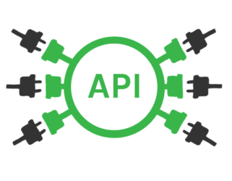


Data Exchange Lifecycle (Runtime)
Data (file) arrival
API Publication
Data pipeline
(Transformation or passthrough)
Identification
PubSub Notification
Data Publication (WAF)

Slide 13
WIS2 Components and Standards
Component | Protocol/Interface/API | Content/Encoding(s)
Global Discovery Catalogue Message Replay API | HTTP/S OpenAPI OGC API – Records – Part 1: Core | WCMP2 Topic hierarchy Notification message
Global Broker | MQTT/S | Notification message
Global Cache | HTTP/S | Programme specific: GRIB2 BUFR4 WaterML2 CF/NetCDF GeoJSON
WIS2 Node | HTTP/S MQTT/S | WCMP2 Topic hierarchy Notification message
Global Monitoring | HTTP/S | OpenMetrics

Slide 14
Topic hierarchy implementation
Topics drive dataset ingest and publication
Dataset pipelines
Data mapping configuration
Discovery metadata
functionality implemented in pywcmp
List topics
Validate topics
github.com/wmo-im/pywcmp

Slide 15
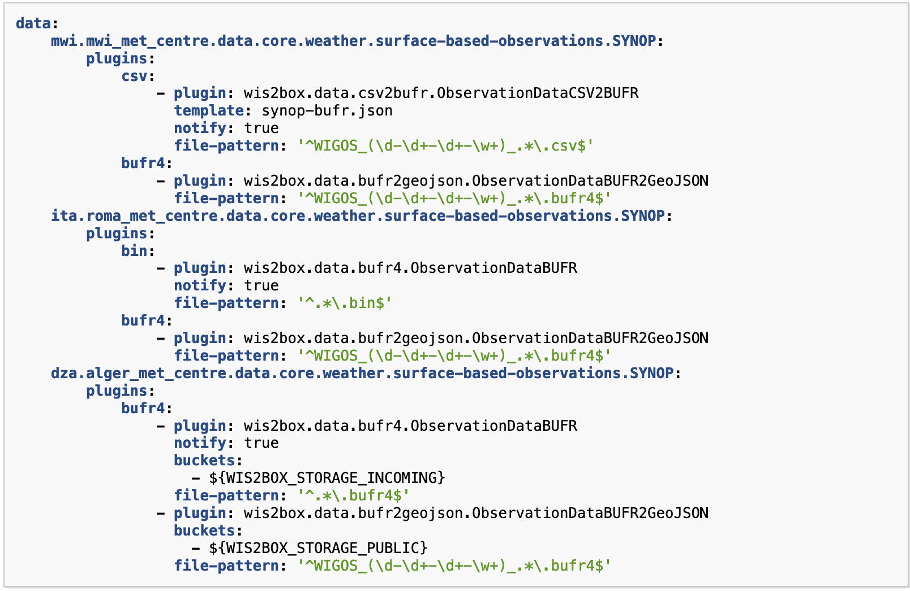
Topic hierarchy implementation

Slide 16
Notification message implementation (GeoJSON RFC7946)
Sending data notifications
Provided as API endpoint for replay workflow/use case
Full support of GeoJSON geometries
WSI:
Adds properties.wigos_station_identifier
Functionality implemented in pywis-pubsub
Standalone implementation for data subscription/download
github.com/wmo-im/pywis-pubsub

Slide 17
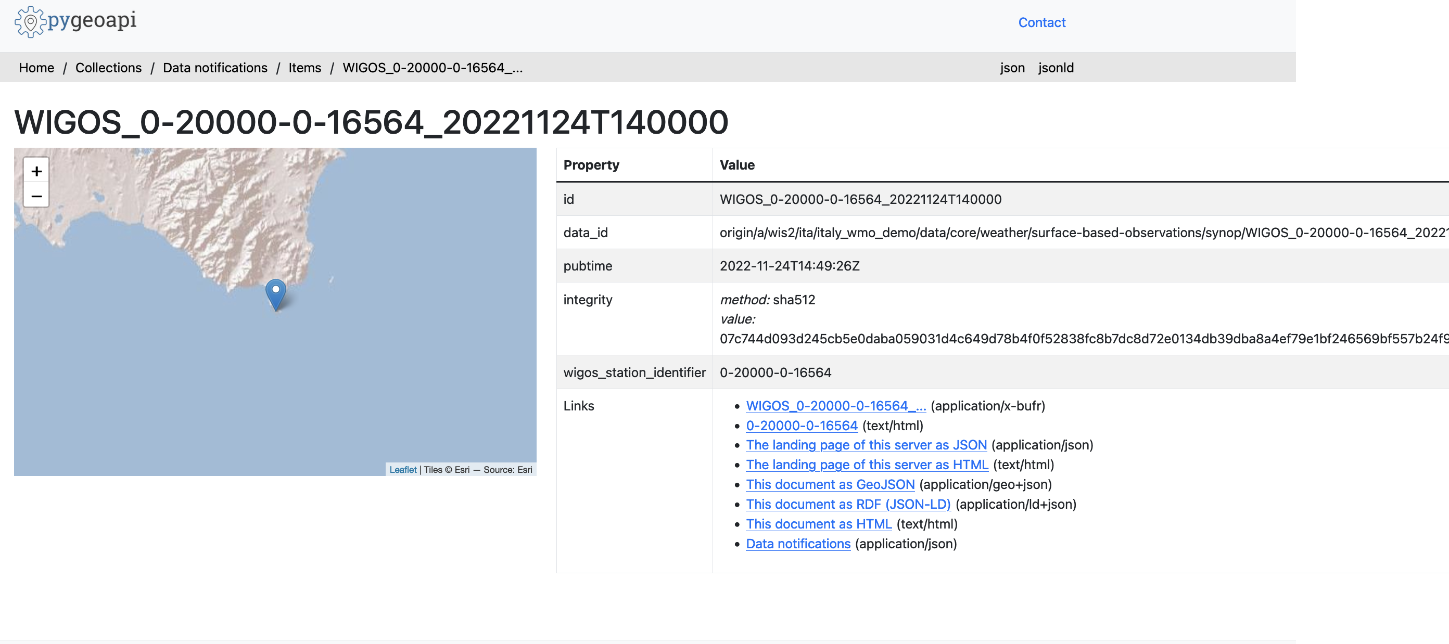
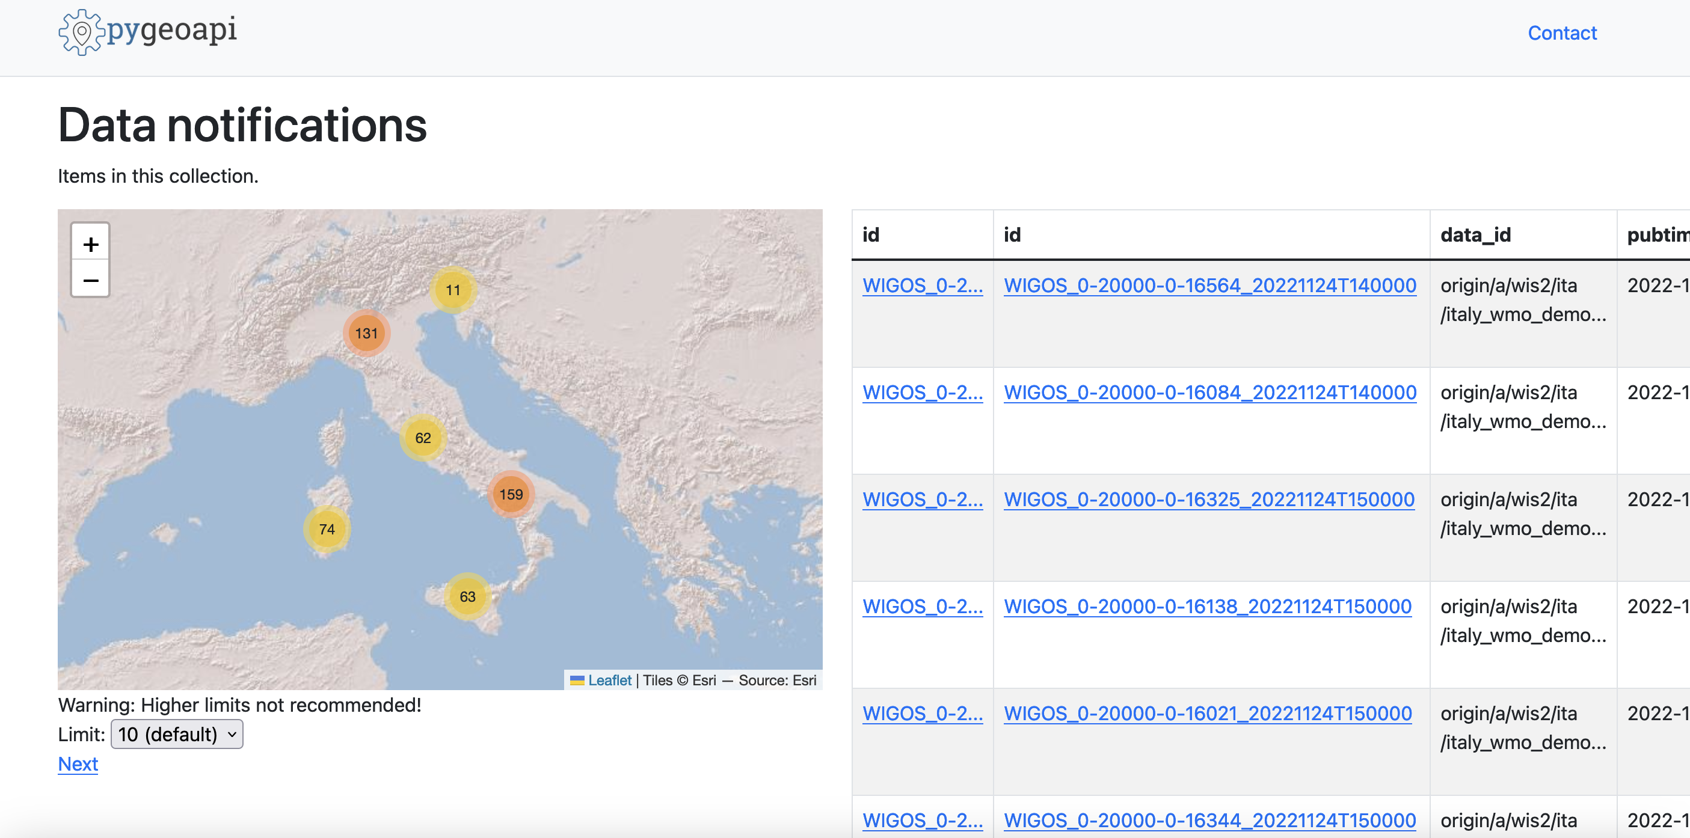
Notification message implementation (GeoJSON RFC7946)
Replay API

Slide 18
Discovery metadata implementation (WCMP2)
WMO Core Metadata Profile 2 (WCMP2)
Metadata curation/management
UI in development
Profile of OGC API – Records standard
Implemented in numerous tools:
pygeometa
pygeoapi
pycsw
OWSLib
MetaSearch

Slide 19
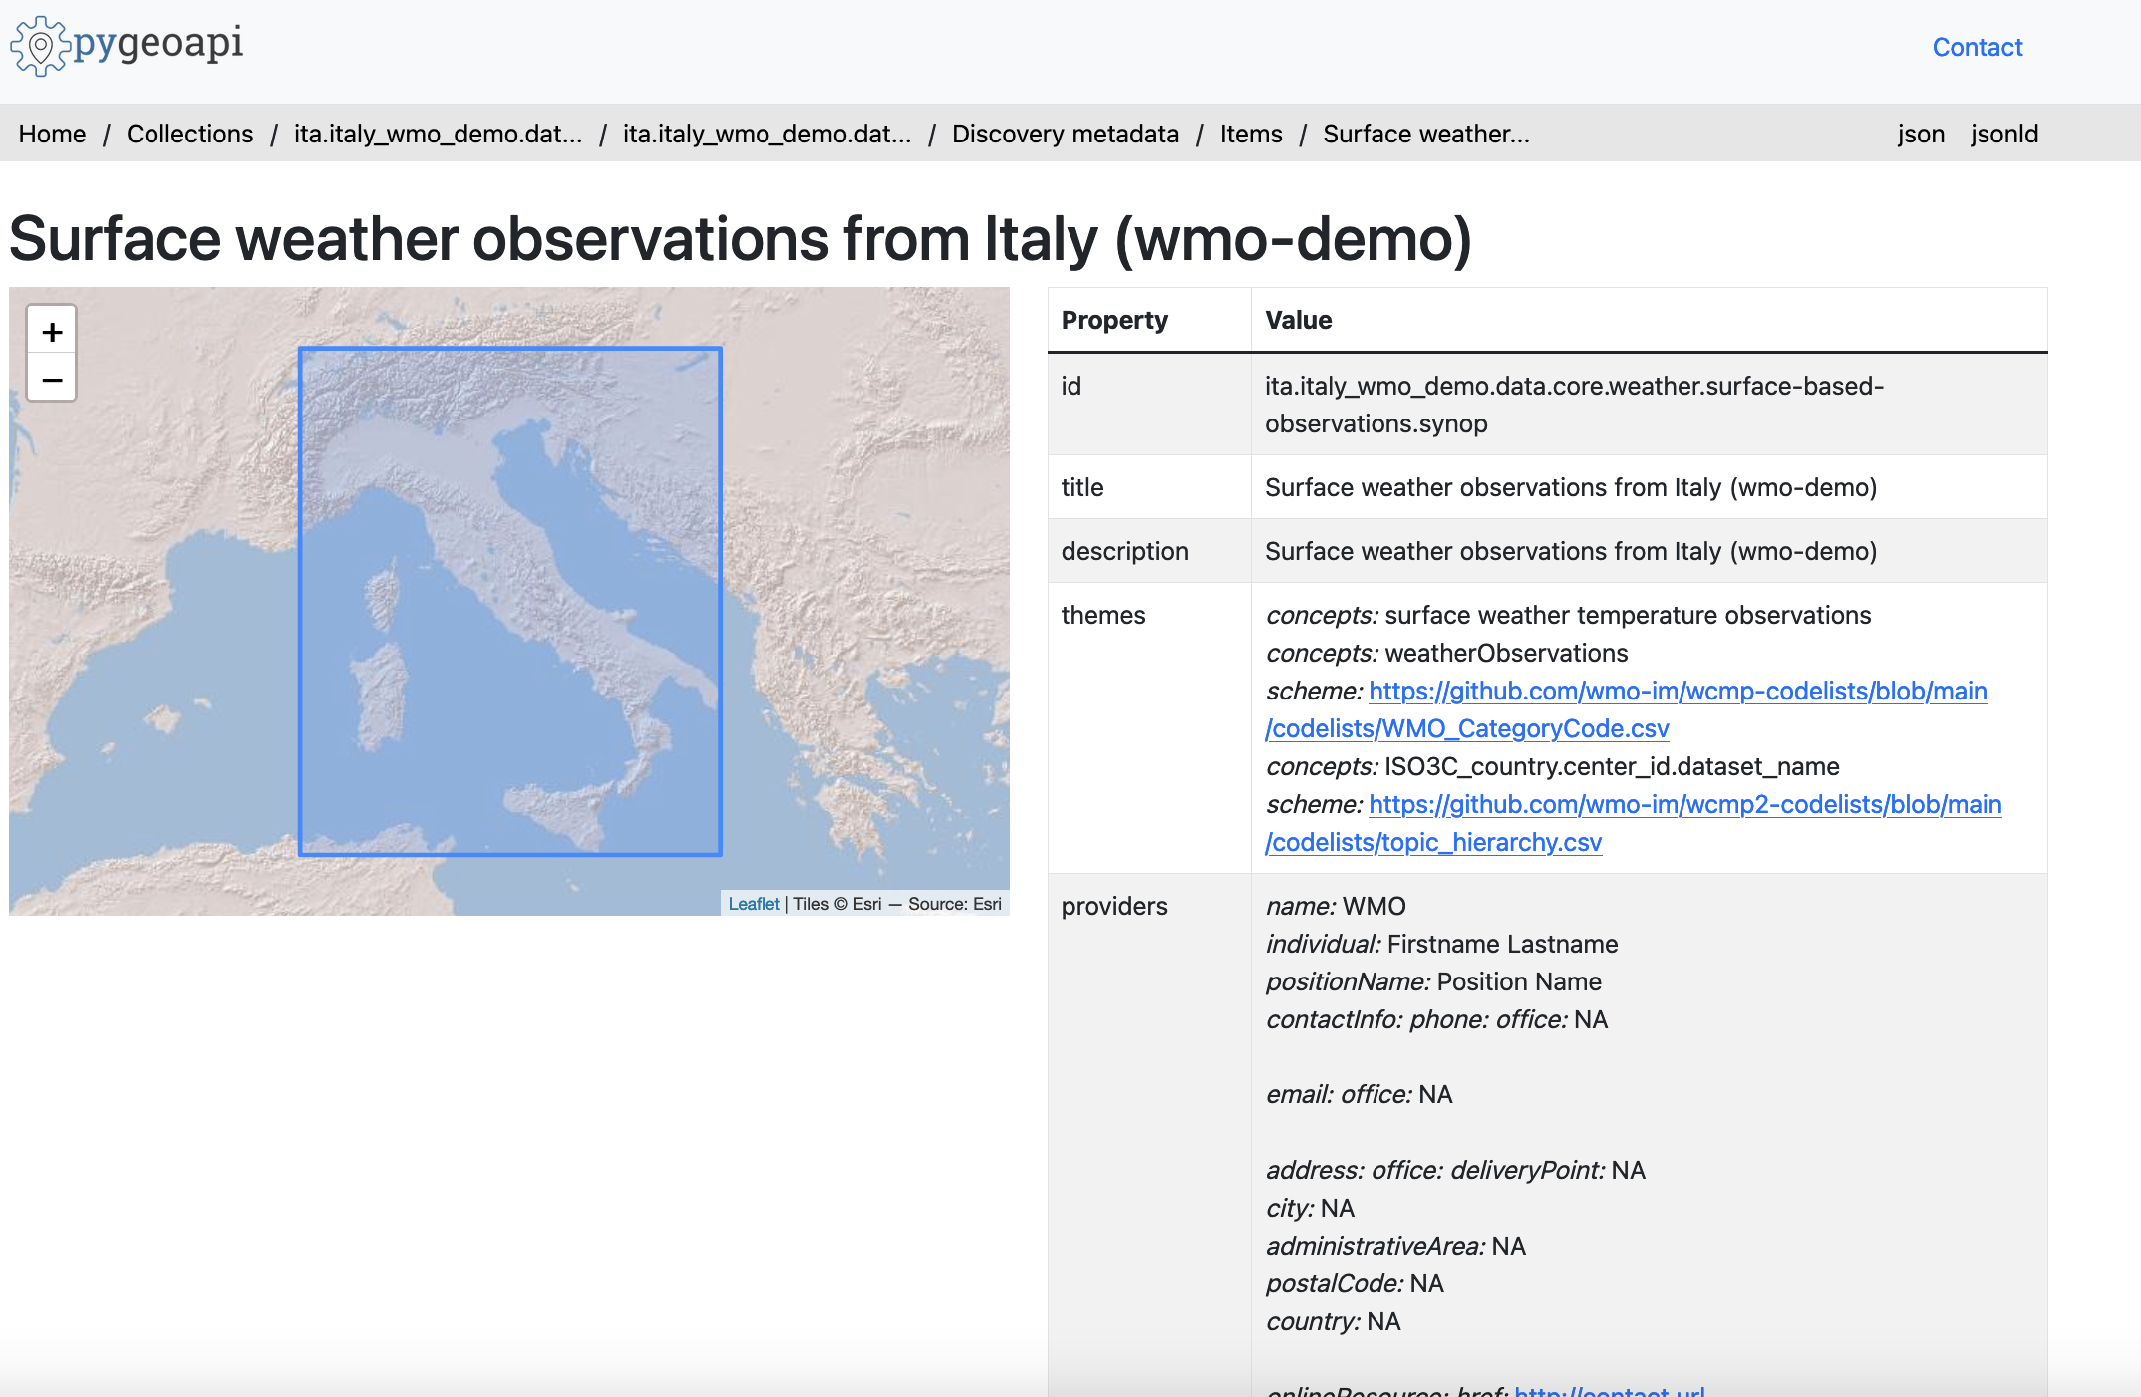
Discovery metadata implementation (WCMP2)

Slide 20
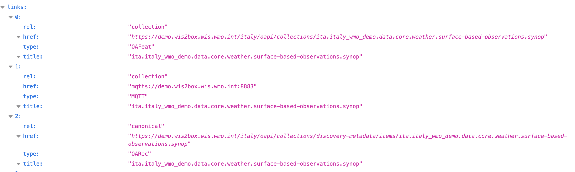
Discovery metadata implementation (WCMP2)

Slide 21

WIS2 in a box is Open
GitHub repositories and documentation
Code: github.com/wmo-im/wis2box
Documentation: docs.wis2box.wis.wmo.int
Forum: github.com/wmo-im/wis2box/discussions
Apache License, Version 2.0
Permissions
Commercial use
Distribution
Modification
Patent use
Private use
Conditions
License and copyright notice
State any changes
Limitations
Liability
Trademark use
Warranty

Slide 22

Thank you
Merci
Gracias
شكرا
谢谢

